Slide 1
UNIT 2 : STATISTICAL CONCEPTS FOR DATA SCIENCE
Role of Statistics in Data Science; Population vs. Sample; Descriptive vs. Inferential statistics; Probability distributions: Poisson, Normal, Binomial, Uniform; Bayes' theorem and conditional probability; Descriptive statistics: Measures of central tendency: Mean, median, mode; Measures of dispersion: Variance, standard deviation; Inferential statistics: Hypothesis testing: Null and alternative hypotheses, p-values; Confidence intervals, ANOVA, Chi-square test, T-test; Correlation and Covariance
1

Slide 2
2.1 Role of Statistics in Data science
Statistics is the science of collecting, organizing, analyzing, interpreting, and presenting data to support decision-making and problem-solving.
Function | Description
Collection | Gathering raw data through surveys, sensors, experiments, etc.
Organization | Arranging data in tables, charts, or graphs for better understanding
Analysis | Applying mathematical techniques (mean, median, etc.) to extract meaning
Interpretation | Drawing conclusions or identifying patterns from analyzed data
Presentation | Communicating results using reports, dashboards, or visualizations
2

Slide 3
Applications of Statistics
Field | Application Example
Business | Market analysis, customer satisfaction surveys
Healthcare | Clinical trials, patient data analysis
Government | Population census, budget planning
Sports | Player performance metrics, match predictions
Education | Analyzing exam results, predicting dropout rates
2

Slide 4
2.2 Population Vs Sample
Concept | Population | Sample
Definition | Entire group under study | A subset of the population
Size | Usually large (sometimes infinite) | Smaller, manageable size
Purpose | Contains all the data or individuals of interest | Used to estimate or make inferences about the population
Accuracy | High (if measured directly) | Depends on how well the sample represents the population
Cost and Time | Expensive and time-consuming | Less costly and quicker to analyze
Example | All citizens of India | 1,000 surveyed citizens from across India

Slide 5
Difficulty of considering population
Real-Time Case Study: COVID-19 Vaccination Survey
Objective: Understand vaccine side effects across India.
Population: All vaccinated individuals in India (~100 crore).
Challenge: Impossible to contact all due to cost, time, and availability.
Solution: A sample of 10,000 individuals was selected across states, age groups, and genders. Researchers used stratified sampling to ensure fair representation.
Outcome:
Quicker data collection
Actionable insights shared with healthcare professionals
Policy changes made based on sample findings

Slide 6
Difficulty in Taking Population
🧩 Difficulty in Taking Population
Logistics: Difficult to reach everyone.
Non-response: Not everyone may respond, leading to missing data.
Ethical Concerns: Privacy issues in large-scale data collection.
Dynamic Nature: Populations change over time (e.g., migration, deaths, births).

Slide 7
Sampling Types
Sampling is the process of selecting a subset (sample) from a larger group (population) to analyze and make conclusions about the whole.
✅ Types of Sampling
1. Random Sampling
Definition: Every member of the population has an equal chance of being selected.
Example:
You have a list of 100 students.
You write all their names on slips and pick 10 slips randomly.
Everyone had the same chance of being picked.
✅ Used when: You want to eliminate bias and ensure fairness.
2

Slide 8
Sampling Types
2. Condition-Based Sampling (also called Stratified or Purposive Sampling, depending on usage)
Definition: You select samples based on a specific condition or criteria.
Example:
You want feedback only from students who scored above 90% in exams.
You filter the data first, then select from those matching the condition.
✅ Used when: You're interested in a particular group (e.g., high scorers, urban people, customers who bought more than ₹1000, etc.)
2

Slide 9
Sampling Types
3. Sequential Sampling
Definition: Samples are chosen in a sequence, either until a condition is met or to continuously monitor.
Example:
A company checks every 10th item on the production line.
If a defective item is found, they test the next 5 items in a row.
✅ Used when: You want to monitor things over time or catch problems quickly.

Slide 10
Sampling Types
Sampling Type | How It Works | Real-Life Example | Best Use Case
Random Sampling | Everyone has equal chance | Picking 5 students randomly from a class | When you need fairness
Condition-Based Sampling | Based on rules or filters | Selecting students scoring >90% | When targeting a specific group
Sequential Sampling | Sample in order, one-by-one | Checking every 10th biscuit in a factory | For quality control / monitoring

Slide 11
Statistics Types – Descriptive and Inferential Statistics
1. Descriptive Statistics – Definition & Introduction
Definition: Descriptive statistics involves summarizing and organizing data so it can be easily understood. It focuses on the actual data collected.
Purpose: To describe the main features of a dataset using numbers, tables, and graphs.
Common tools include:
Measures of Central Tendency: Mean, Median, Mode
Measures of Variability/dispersion: Range, Variance, Standard Deviation
Visualizations: Bar charts, histograms, pie charts, etc.
Example: You collect exam scores of 100 students and calculate the average score, highest and lowest marks – that’s descriptive statistics.

Slide 12
Statistics Types – Descriptive and Inferential Statistics
2. Inferential Statistics – Definition & Introduction
Definition: Inferential statistics involves using a sample of data to make predictions, inferences, or generalizations about a larger population.
Purpose: To draw conclusions beyond the immediate data – like estimating population parameters, testing hypotheses, or making predictions.
Common tools include:
Hypothesis testing
Confidence intervals
Regression analysis
ANOVA, Chi-square tests
Example: You survey 100 people about their food preferences and use the results to predict what the entire city might prefer – that’s inferential statistics.
2

Slide 13
Descriptive vs Inferential Statistics
Concept | Descriptive Statistics | Inferential Statistics
Definition | Methods to summarize and describe data | Methods to draw conclusions or predictions from a sample
Data Used | Uses entire dataset or sample | Uses sample data to infer about the population
Common Techniques | Mean, median, mode, standard deviation, charts | Hypothesis testing, confidence intervals, regression, t-tests
Goal | Describe what has happened | Predict or generalize what will happen
Example | "The average age of employees is 34 years." | "We are 95% confident the average age of all employees is between 32 and 36."
2

Slide 14
Applications of descriptive and Inferential Statistics
Simple Example:
A teacher wants to know how well her class did on a test. She calculates the mean score, median, and highest and lowest marks. This is an application of descriptive statistics.
If she uses this class’s scores to predict how students in the school may perform, she’s applying inferential statistics.
2

Slide 15
2.3 Descriptive Statistics
🧮 Descriptive Statistics
Purpose: To describe the main features of a dataset.
Includes:
Measures of central tendency (mean, median, mode)
Measures of variability (range, variance, standard deviation)
Data visualization (bar chart, pie chart, histogram)
2

Slide 16
Descriptive Statistics
✅ Real-Life Case Study: School Exam Scores
A teacher collects the exam marks of all students in her class of 40.
Metric | Value
Mean | 75
Median | 78
Mode | 80
Std Dev | 5
What it does: Describes how students in this particular class performed.
No prediction is made about other classes or schools.
2

Slide 17
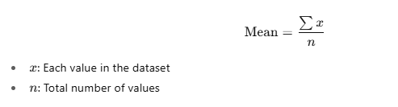
Measure of Central tendency
🔹Measures of Central Tendency
Definition: Measures of central tendency help us identify the center or typical value of a dataset. They summarize a dataset with a single representative number.
1. ✅ Mean (Arithmetic Average)
Definition: The average of all the values. Formula:

Slide 18
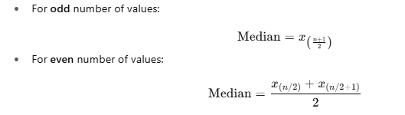
Measure of Central tendency
import numpy as np
data = [12, 15, 20, 22, 18]
mean = np.mean(data)
print("Mean:", mean)
2. Median
Definition: The middle value when data is sorted in ascending order.. If even number of values, median is the average of the two middle numbers.
2

Slide 19
Measure of Central tendency
data_odd = [3, 5, 1]
data_even = [10, 2, 4, 8]
print("Median (odd):",
np.median(data_odd)) # Output: 3.0
print("Median (even):",
np.median(data_even)) # Output: 6.0
2

Slide 20
Measure of Central tendency
✅ Mode
Definition: The value that occurs most frequently in a dataset.
If no value is repeated, then no mode exists.
A dataset can also have multiple modes (bimodal/multimodal).
🔸 Case 1: Single Mode (Unimodal)
✅ Example: Data = [2, 4, 4, 6, 8] Mode = 4 (it appears twice)
🔸 Case 2: Multiple Modes (Multimodal)
✅ Example: Data = [1, 2, 2, 3, 3, 4] Modes = 2 and 3 (both occur twice) Python returns all of them with .mode().
2

Slide 21
Measure of Central tendency
🔸 Case 3: No Repeated Value (No Mode)
✅ Example: Data = [5, 7, 9, 11] Each value appears only once → No mode.
📌 In Python, pandas.Series.mode() returns all values in this case.
2

Slide 22
Measure of Variability/ Dispersion
2. Measures of Variability (Dispersion)
Definition: These measures indicate how spread out the values in the dataset are from the center (mean or median).
✅ Range
Definition: The difference between the maximum and minimum values. Formula:
Range=Max−Min
data = [10, 2, 8, 6]
print("Range:", max(data) - min(data)) # Output: 8
2

Slide 23

Measure of Variability/Dispersion
✅ Variance
Definition: The average of the squared differences from the mean. Formula (Sample Variance):
import numpy as np
data = [2, 4, 6, 8]
variance = np.var(data, ddof=1) # ddof=1 for sample variance
print("Variance:", variance)
2

Slide 24

Measure of Variability/Dispersion
✅ Standard Deviation (SD)
Definition: The square root of variance. Shows how much the values deviate from the mean. Formula:
std_dev = np.std(data, ddof=1)
print("Standard Deviation:", std_dev)
2

Slide 25
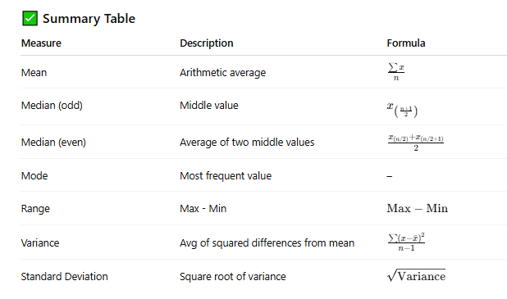
Measure of Central tendency
2

Slide 26

Measure of Dispersion - Quartiles
Definition: Divide the dataset into 4 equal parts.
Q1 (25%), Q2 (50%), Q3 (75%)
Formula (for sorted data):
Use: Identify the spread and median of the data

Slide 27

Measure of Dispersion - Quintiles
Definition: Divide the dataset into 5 equal parts.
Quintiles: Q1 (20%), Q2 (40%), Q3 (60%), Q4 (80%)
Formula:
Use: Used in economic data and income distribution.
2

Slide 28

Measure of Dispersion - Deciles
Definition: Divide the dataset into 10 equal parts.
Deciles: D1 (10%) to D9 (90%)
Formula:
Use: Common in educational grading and income ranking.
2

Slide 29

Measure of Dispersion - Percentiles
Definition: Divide the dataset into 100 equal parts.
P1 (1%) to P99 (99%)
Formula:
Use: Used in tests, assessments, and analytics.

Slide 30
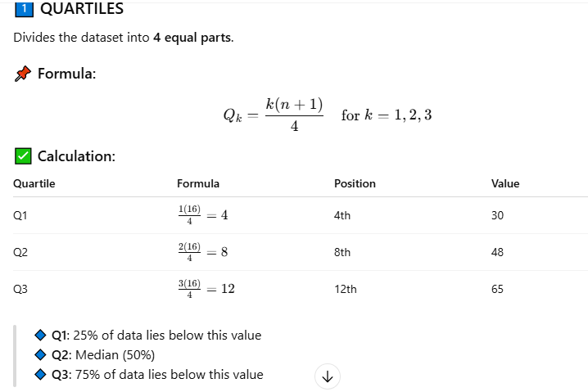
2

Slide 31
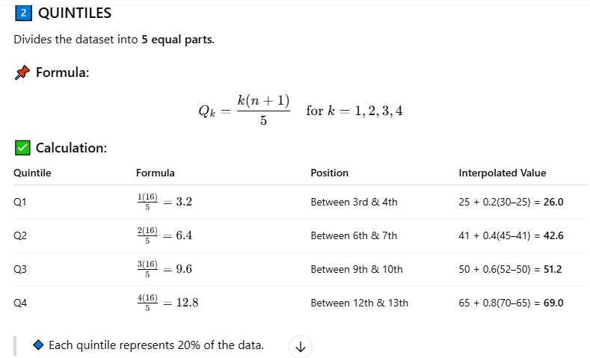
Measure of Dispersion - Percentiles
2

Slide 32
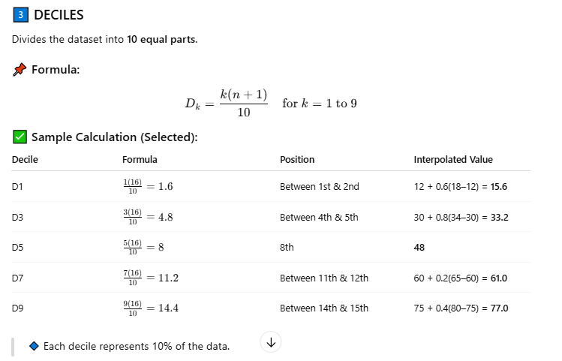
2

Slide 33
Inferential Statistics
✅ Real-Life Case Study: Voter Opinion Poll
A survey is conducted with a sample of 2,000 voters across Tamil Nadu to predict the outcome of an upcoming election.
Finding: 52% favor Party A, with a margin of error of ±3%.
What it does: Makes predictions about all voters in Tamil Nadu (the population), based on a sample.

Slide 34
2.4 Probability Distributions
✅ Real-Life Example
Imagine you're running a bakery.
On average, 30 customers visit your shop every day.
But some days it's 28, some days 35, or sometimes only 25.
You wonder:
What’s the chance exactly 32 customers will visit tomorrow?
What’s the most likely number of customers to expect on a weekend?
This is where probability distribution comes in—it helps you answer such practical questions by modeling uncertainty.
2

Slide 35
Probability Distribution
📌 Types of Probability Distributions
Type | Used For | Example
Binomial | Success/failure trials | Tossing a coin multiple times
Poisson | Events per time unit | Number of emails per hour
Normal | Naturally occurring data (bell curve) | Human height, test scores

Slide 36
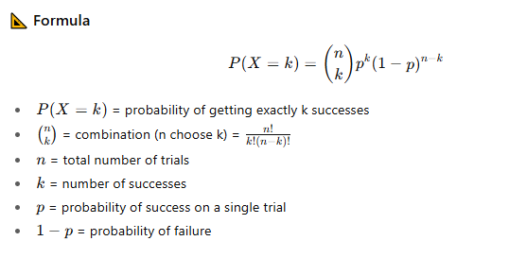
Binomial Distribution
Definition : The Binomial Distribution is a discrete probability distribution that models the number of successes in a fixed number of independent Bernoulli trials, where each trial has only two possible outcomes: Success (S) or Failure (F).
2

Slide 37
Binomial Distribution
✅ Conditions for Using Binomial Distribution
Use it when:
The number of trials ‘n’ is fixed.
Each trial is independent.
Each trial results in only two outcomes (success/failure).
The probability of success ‘p’ remains the same for each trial.

Slide 38
Applications of Binomial distribution
📌 Applications
Quality control: Number of defective items in a batch
Medicine: Patients responding to a treatment
Education: Number of students passing an exam
Marketing: Number of customers who respond to a campaign
2

Slide 39
Example Scenario- Binomial Distribution
"A machine has a 70% chance of producing a good item. What is the probability of getting exactly 0 to 10 good items out of 10 trials?“
import numpy as np
import matplotlib.pyplot as plt
from scipy.stats import binom
# Parameters for Binomial Distribution
n = 10 # Number of trials
p = 0.7 # Probability of success in each trial
# Range of possible successful outcomes: 0 to n
x = np.arange(0, n+1)
# Calculate PMF (Probability Mass Function)
pmf_values = binom.pmf(x, n, p)

Slide 40
Example Scenario- Binomial Distribution
# Print the probabilities for each outcome
for i, prob in zip(x, pmf_values):
print(f"P(X = {i}) = {prob:.4f}")
# Plotting the distribution
plt.figure(figsize=(10, 6))
plt.bar(x, pmf_values, edgecolor='black', alpha=0.7)
plt.title('Binomial Distribution PMF (n=10, p=0.7)')
plt.xlabel('Number of Successes (X)')
plt.ylabel('Probability')
plt.grid(axis='y', linestyle='--', alpha=0.7)
plt.xticks(x)
plt.show()

Slide 41
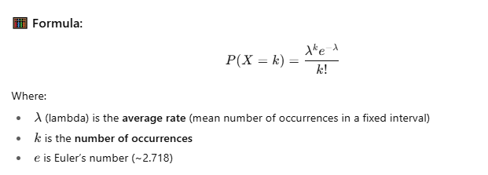
Poisson Distribution
The Poisson distribution models the probability of a given number of events occurring within a fixed interval of time or space, if these events occur with a known constant mean rate and independently of the time since the last event.
2

Slide 42
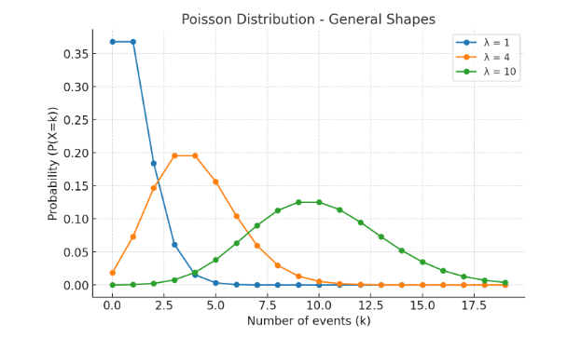
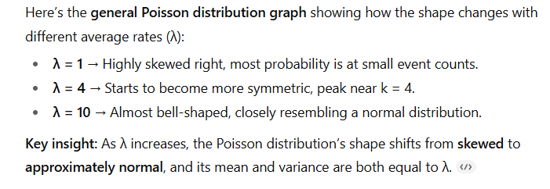

Slide 43
Poisson Distribution
🎯 When to Use Poisson Distribution:
Number of emails received per hour
Number of customer arrivals per minute
Number of defects per meter in a wire
Number of accidents at a junction per day
🧪 Applications:
Traffic flow analysis
Queuing theory
Call centers
Reliability engineering
2

Slide 44
Poisson Distribution
📌 Scenario:
You're analyzing how many customer support calls a small company receives in an hour. Based on past data, the average rate is 4 calls per hour. You want to model the probability of receiving 0 to 14 calls in a given hour.
import numpy as np
import matplotlib.pyplot as plt
from scipy.stats import poisson
# Scenario:
# A company receives an average of 4 support calls per hour.
# We want to find the probability of receiving 0 to 14 calls in an hour.
# Step 1: Define the average rate (λ)
lambda_calls = 4 # Average number of calls per hour
# Step 2: Define the range of possible call counts (0 to 14)
x = np.arange(0, 15) # Possible values of number of calls

Slide 45
Poisson Distribution
# Step 3: Calculate the probability mass function (PMF) using scipy
# PMF gives the probability of getting exactly x calls in an hour
pmf_values = poisson.pmf(x, mu=lambda_calls)
# Step 4: Display the probability for each number of calls
print("Probability of receiving k calls in an hour:")
for k, prob in zip(x, pmf_values):
print(f"P(X = {k}) = {prob:.4f}")
# Step 5: Visualize the Poisson distribution
plt.figure(figsize=(10, 6))
plt.bar(x, pmf_values, color='skyblue', edgecolor='black')
plt.title('Poisson Distribution: Support Calls per Hour (λ = 4)')
plt.xlabel('Number of Calls in an Hour')
plt.ylabel('Probability')
plt.grid(axis='y', linestyle='--', alpha=0.7)
plt.xticks(x)
plt.show()
:
2

Slide 46
Normal Distribution
:
Definition: The Normal Distribution (also called the Gaussian Distribution) is a continuous probability distribution where: Data tends to cluster around a mean (μ).
It is symmetric — the left and right halves are mirror images.
The spread is measured by standard deviation (σ).
The graph is bell-shaped.
In a normal distribution, the mean, median, and mode are all equal.
A smaller standard deviation means the data is clustered more tightly around the mean, resulting in a taller, narrower curve. A larger standard deviation means the data is more spread out, resulting in a wider, flatter curve.
2

Slide 47
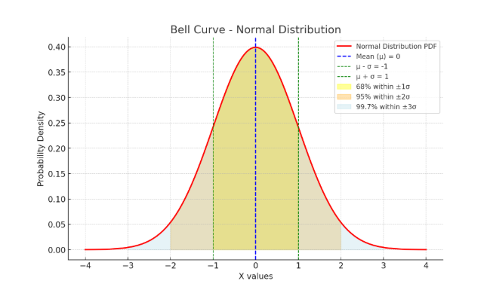
Normal Distribution
:
The bell shape means most data points are close to the mean.
The curve is perfectly symmetric — left side mirrors the right side.
Mean - The vertical dashed blue line at μ=0μ = 0μ=0 is the center of the distribution.
Outliers : The extreme left/right tails represent rare events.
In data science, points in these tails are often considered outliers.
2

Slide 48
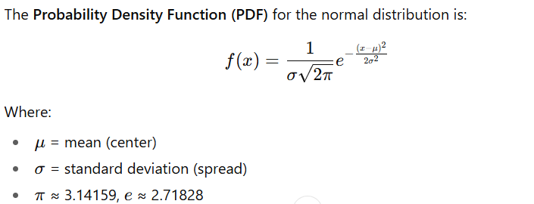
Normal Distribution
:
Formula
The Probability Density Function (PDF) for the normal distribution is:

Slide 49
Normal Distribution
:
Applications
Data analysis – modeling natural phenomena.
Machine learning – feature standardization for algorithms like logistic regression, SVM, KNN.
Quality control – detecting defects using control charts.
Finance – modeling asset returns (with caveats).
2

Slide 50
Normal Distribution
:
Example Scenario
Imagine we are analyzing student test scores in a class. Scores are normally distributed with a mean of 70 and a standard deviation of 10.
We want to:
Plot the probability density curve.
Simulate random scores and visualize them.

Slide 51
Normal Distribution
import numpy as np
import matplotlib.pyplot as plt
from scipy.stats import norm
# Parameters
mu = 70 # mean
sigma = 10 # standard deviation
# Generate x values (range of scores)
x = np.linspace(mu - 4*sigma, mu + 4*sigma, 1000)
# Calculate PDF values
pdf = norm.pdf(x, mu, sigma)
# Generate random sample data
np.random.seed(42)
sample_scores = np.random.normal(mu, sigma, 1000)
:
2

Slide 52
Normal Distribution
:
# Plot PDF curve
plt.figure(figsize=(8,5))
plt.plot(x, pdf, label=f'N({mu}, {sigma}²)', color='red', linewidth=2)
plt.hist(sample_scores, bins=30, density=True, alpha=0.6, color='skyblue', edgecolor='black')
plt.title("Normal Distribution - Student Scores")
plt.xlabel("Score")
plt.ylabel("Density")
plt.legend()
plt.grid(True, linestyle='--', alpha=0.6)
plt.show()
2

Slide 53
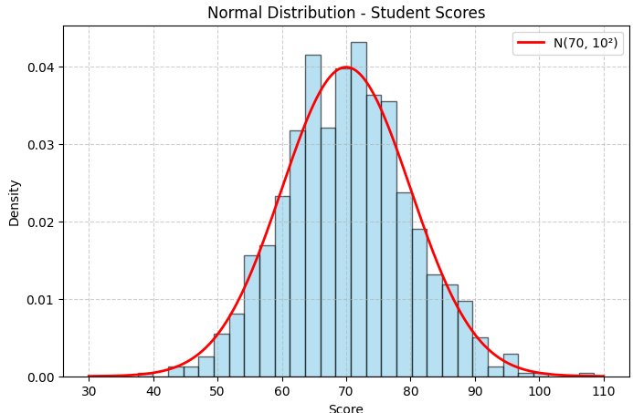
Normal Distribution
:
2

Slide 54
Uniform Distribution
:
A uniform distribution is a probability distribution where each outcome in a defined range has an equal probability of occurring.
Key characteristics:
Equally likely outcomes:
Every value within the range has the same probability of being selected.
Constant probability density function:
The probability density function (PDF) is a horizontal line within the defined range, indicating constant probability.
Defined range:
The distribution is defined by a minimum (a) and maximum (b) value, denoted as U(a, b).
2

Slide 55
Uniform Distribution
Continuous or discrete:
A uniform distribution can be continuous, where the variable can take any value within the range, or discrete, where the variable can only take specific, separate values.
Examples:
Continuous Uniform Distribution: Rolling a ball down a ramp where the landing spot is equally likely to be anywhere along the ramp's length.
Discrete Uniform Distribution: Flipping a fair coin, where the probability of heads or tails is 1/2.
:
2

Slide 56
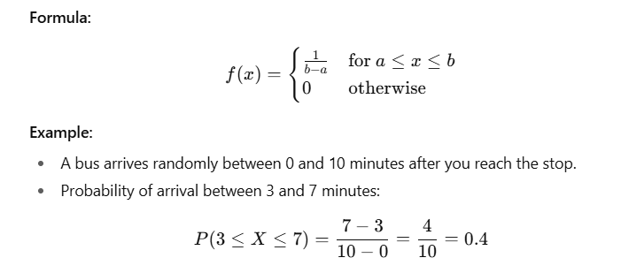
Uniform Distribution
1. Continuous Uniform Distribution
Definition:
All values in a given interval [a,b] are equally likely.
The probability is spread evenly across the entire range.
Since there are infinitely many possible values, the probability of any single exact value is 0 — we talk about interval probabilities instead.
:
2

Slide 57
Uniform Distribution
:
Applications:
Random number generation between two real numbers.
Simulation models.
Assigning equal chance over a continuous measurement (time, length, temperature).
2

Slide 58
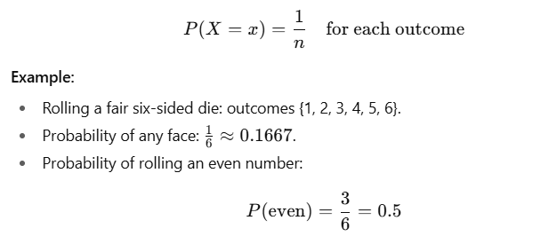
Uniform Distribution
2. Discrete Uniform Distribution
Definition:
All finite, discrete values in a set are equally likely.
Since the set is countable, we can assign equal probability to each value.
Formula: If there are n equally likely outcomes:
:
2

Slide 59
Uniform Distribution
:
Applications:
Dice games, lottery draws.
Selecting a random record from a database.
Random shuffling of discrete items.
2

Slide 60
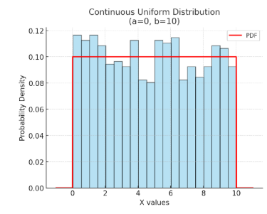
Uniform Distribution
1. Continuous Uniform Distribution (Left Plot)
Example: Bus arrives anytime between 0 and 10 minutes.
Red line: The PDF (flat line), meaning every time in that range is equally likely.
Blue histogram: Simulated random arrivals — spread evenly.
Probability density is constant between 0 and 10.
:
2

Slide 61
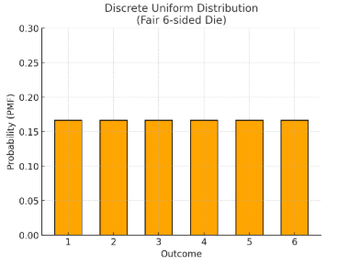
Uniform Distribution
2. Discrete Uniform Distribution (Right Plot)
Example: Rolling a fair six-sided die.
Each bar (orange) represents an outcome {1, 2, 3, 4, 5, 6}.
Each has equal height = (1/6) probability.
Probabilities are equal and fixed for each outcome.
:
2

Slide 62
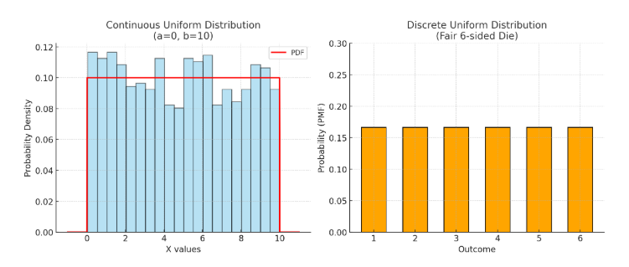
Uniform Distribution
:
2

Slide 63
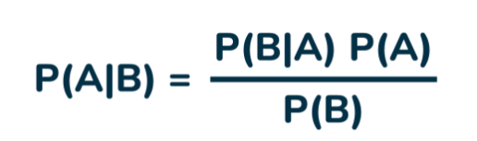
Bayes' Theorem
Bayes' Theorem is a mathematical formula used to determine the conditional probability of an event based on prior knowledge and new evidence. It adjusts probabilities when new information comes in and helps make better decisions in uncertain situations.
Bayes Theorem Formula
P(A) and P(B) are the probabilities of events A and B;
also, P(B) is never equal to zero.
P(A|B) is the probability of event A when event B happens,
P(B|A) is the probability of event B when A happens.

Slide 64
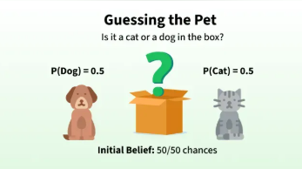


Slide 65
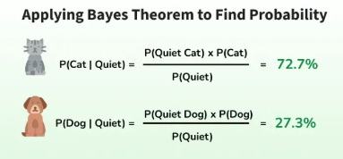

Slide 66
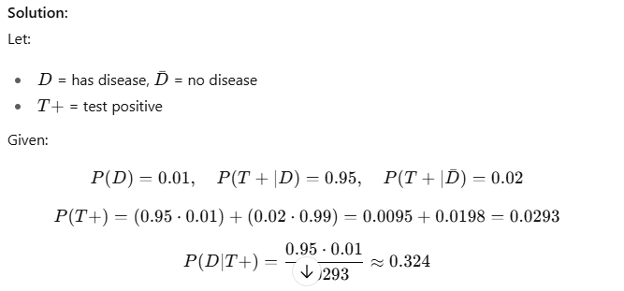
Problem 1: Medical Test
A disease affects 1% of the population. The test is 95% accurate for diseased people (true positive) and gives 2% false positives for healthy people. If a person tests positive, what is the probability they actually have the disease?

Slide 67
Problem 2: Factory Defects
A factory has 3 machines:
M1 makes 40% of products, defect rate = 1%
M2 makes 35% of products, defect rate = 2%
M3 makes 25% of products, defect rate = 3%
If a randomly chosen product is defective, find the probability it was made by M2.

Slide 68
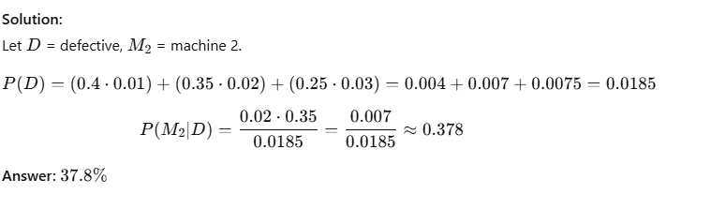
Problem 2: Factory Defects
A factory has 3 machines:
M1 makes 40% of products, defect rate = 1%
M2 makes 35% of products, defect rate = 2%
M3 makes 25% of products, defect rate = 3%
If a randomly chosen product is defective, find the probability it was made by M2.

Slide 69
Key concepts
Prior Probability: Initial beliefs or assumptions about the likelihood of an event, independent of the current data.
Likelihood Function: Quantifies how probable the observed data is given a specific set of model parameters or a particular hypothesis.
Posterior Probability: The updated probability of an event after incorporating new data or evidence, taking into account both the prior belief and the likelihood of the data.

Slide 70
How it's applied in data science
Classification:
Naïve Bayes Classifiers: These are algorithms that utilize Bayes' Theorem, making the simplifying assumption that features are independent of each other (the "naive" assumption).
Examples: Spam detection (probability an email is spam given certain words), sentiment analysis (probability a review is positive given certain phrases), medical diagnosis (probability of disease given symptoms).

Slide 71
Bayesian Inference:
This approach uses Bayes' theorem to update the probability of a hypothesis as more evidence becomes available.
Updating Beliefs: Instead of a single estimate (like in frequentist statistics), Bayesian inference provides a probability distribution over possible values, allowing models to refine predictions with new data.

Slide 72
Recommendation Systems: Predicting user preferences and suggesting items based on past interactions.
Autonomous Vehicles: Making real-time decisions in uncertain environments based on sensor data.
Financial Market Analysis: Predicting stock prices and assessing risk.
Search Engines: Ranking web pages based on query relevance

Slide 73
Conditional Probability
Conditional probability defines the probability of an event occurring based on a given condition or prior knowledge of another event.
It is the likelihood of an event occurring, given that another event has already occurred. In probability, this is denoted as A given B, expressed as P(A | B), indicating the probability of event A when the event B has already occurred.

Slide 74
Question: What are the chances that its raining given that you carry an umbrella?
Given:
It rains 30% of the time
You carry an umbrella 50% of the time
When it rains, you carry an umbrella 80% of the time
Implies (for 10 days scenario):
3 out of 10 days are rainy. (since 30% of 10 = 3)
5 out of 10 days you carry an umbrella. (since 50% of 10 = 5)
On rainy days, you carry it 2 out of 3 days (since 80% of 3 ~ 2)
Total Umbrella Days:
Rainy days: 2 out of 3
Sunny days: 3 out of 7.
Total umbrella days = 5 (matching the 50% probability).

Slide 75
Conditional Probability:
Out of all umbrella days (5), only 2 days were rainy. Thus, P(Rain | Carry Umbrella) = 2/5 = 40%.

Slide 76
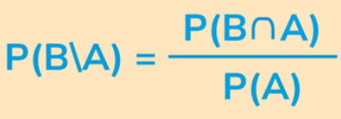
Conditional Probability Formula
Let's consider two events A and B, then the formula for the conditional probability of B when A has already occurred is given by:
P (A ∩ B) represents the probability of both events A and B occurring simultaneously.
P(A) represents the probability of event A occurring.

Slide 77
Conditional Probability Examples
1) Tossing a Coin
Let's consider two events in tossing two coins,
A: Getting a head on the first coin.
B: Getting a head on the second coin. Sample space for tossing two coins is: S = {HH, HT, TH, TT}
The conditional probability of getting a head on the second coin (B) given that we got a head on the first coin (A) is = P(B|A).
Since the coins are independent (one coin's outcome does not affect the other), P(B|A) = P(B) = 0.5 (50%), which is the probability of getting a head on a single coin toss.

Slide 78
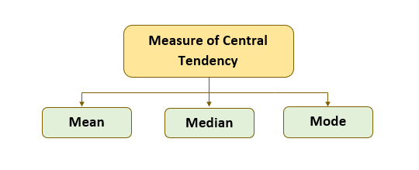
Measures of Central Tendency in Statistics
Measures of central tendency, including the mean, median, and mode, are used in descriptive statistics to represent the typical value of a dataset. They help summarize and understand the center or middle point of a distribution.

Slide 79
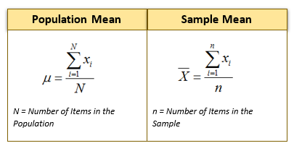
Mean
Mean is equal to the sum of all the values divided by the total number of values.
Mean is the most commonly used measure of central tendency.
Mean is also known as Arithmetic Average.
Mean includes all the values in the data.
Mean is impacted by outlier (extreme) values.
Mean cannot be used for categorical data.
Limitation: Sensitive to extreme values (outliers).

Slide 80
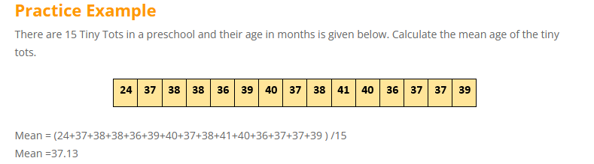
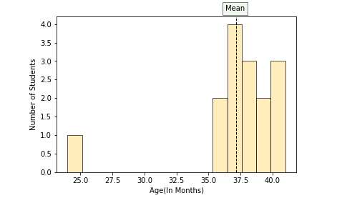

Slide 81

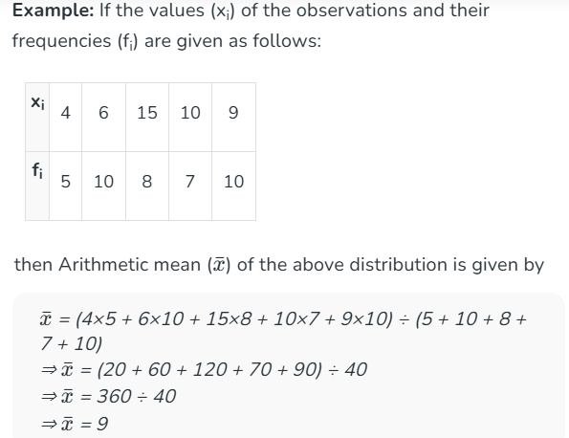
Mean for Grouped Data

Slide 82
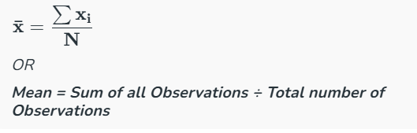
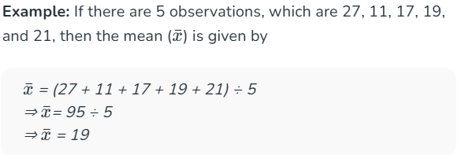
Mean for Ungrouped Data

Slide 83
Median
Median is the middle value of the data when the observations are sorted (ascending or descending order)
When sorted (ascending or descending), the median splits the data into two halves equally (upper and lower halves).
The percentile rank of median = 50%
Median is not calculated based on all the values in data and is therefore not impacted by outliers.
When sorted,
If the number of observations (n) is odd, then the median is the value of the middle observation at position (n + 1) / 2.
Else If the number of observations (n) is even, then the median is the mean of the two middle-most values at position ( n/2, (n+1)/2 ) .

Slide 84
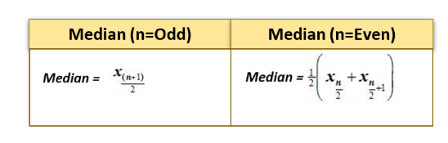

Slide 85
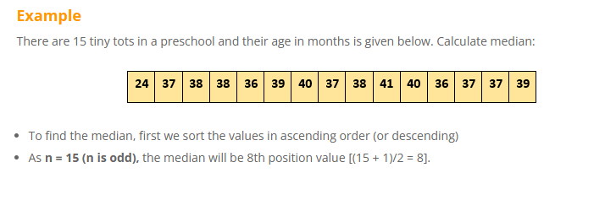
When to Use: Good for skewed data or data with outliers.

Slide 86
3. Mode
Definition: The value(s) that occur most frequently in the dataset.
Example: For data 2,3,3,5,7,7,7,82, 3, 3, 5, 7, 7, 7, 82,3,3,5,7,7,7,8, Mode = 7 (appears most often).
Types:
Unimodal: One mode.
Bimodal: Two modes.
Multimodal: More than two modes.
No mode: If no value repeats.
When to Use: Useful for categorical data (e.g., most common color, most frequent brand).

Slide 87
